Slide 1
Proposed Wyndham Landfill Expansion
Works Approval Application Community Information Session
1 August 2017

Slide 2
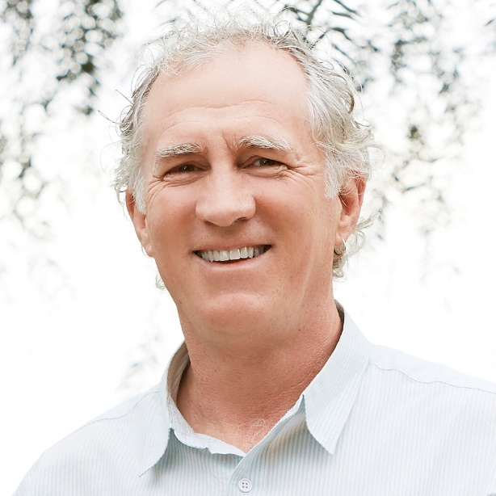
Welcome
Tim Faragher
Manager Development Assessment
EPA Victoria
Simon Clay
Manager Waste Management & Disposal
City Operations
Wyndham City Council
Notes:
Patsy

Slide 3
Purpose
Help explain the works approval process and current status
Help the community to understand more about the new information and how to make a submission
Opportunity for the EPA to gain initial feedback from the community and stakeholders on the new information

Slide 4
EPA role & content
EPA Victoria has two distinct roles with works approval applications
The determining authority for Works Approval Application
A referral agency for any related Planning Permit Application
Notes:
The presentation today will be in two parts
Firstly EPA is the landfill regulator. As such, we are responsible for:
Assessing Works Approval 1002260 which proposes an expansion of the existing Wyndham Landfill.
we also have a role as a Planning Referral Authority.
Our role as a referral authority is to provide advice to the responsible authority about whether a permit should be granted.
In this case a planning permit currently exists.

Slide 5
Works Approval process
Application received
EPA determined to accept application
Referrals and advertising
Newspapers (state and local) and online advertising
Review of submissions
Finalise technical assessment
Decision
Appeal provisions
20B conference where this may assist in just resolution of the matter
Consider submissions and 20B conference
Approval granted / refused
VCAT – Applicant or affected third parties may apply to appeal decision
Input from EPA technical experts
Referrals to relevant agencies
Notes:
CUT: Main steps after application accepted
NOTES:
Final application received on 30 November 2017 and accepted in early December
Because of the comments period running over the Christmas New Year period the usual comments period of 3 weeks was extended by 5 weeks until 7 Feb
Over the whole of this extended period EPA ran internet banner ads informing people of the proposal and directing them to the featured web page on the proposal. This resulted in over 1000 hits to the web site, but only a small number converted to submissions via the web page (13).
Over 170 submissions were received
At any stage during the assessment EPA can request further information under S 22 of the EP Act.
2 s22 notices have been issued (first on 19th January 2017 and second on 10 April 2017)

Slide 6
Review of individual submissions received
Topics of concern
Odour | Airborne litter
Visual amenity | Landfill gas
Better alternatives to landfills | Land impacts
Human Health impacts | Buffers – current and future
Western suburbs taking Melbourne’s waste | Dust
Too close to future residential areas | Fires
Council is driven by the dollar | Land values negative impact
Poor track record | Quality of life
Groundwater | Increased traffic
Surface water | Appropriateness of ‘piggy back cells’
Approval period too long | Appropriateness of modelling
175
Total number of submissions from the community
Notes:
CUT: All raised various concerns about the proposal
NOTES:
This is a snapshot of the responses received. Classified into 3 types – proforma, individual and organisation
24 “individual responses”
136 “proforma responses” representing 146 submitters
5 were from organisations
EPA doesn’t seek to weight responses in any particular way – our main interest is the issues that they raise.
So we undertook our own categorisation of issues to identify key concerns and identify which ones of particular relevance to WA application
---
Also a small number of mentions of dust, fires, negative impact on land values and quality of life, increased traffic and no one mentioned noise.
Odour – Many mentioned personal experience of odour
Visual amenity – the waste mountain, ugly, obscuring the view of the You Yangs
Landfilling an obsolete practise - granting approval would inhibit development of more innovative practises, mentioned waste to energy, full waste recovery, landfilling is so last century.
Human Health Impacts – mentioned but nothing specific except one mention of asthma.
Stigma – The west should not be everyone's dumping ground, all the bad stuff sent out west, environmental justice, intergenerational equity.
Council is driven by the dollar and shows a lack of regard for residents
Poor track record – will only get worse if the landfill is bigger.
Approval period too long – locks in landfilling as a means of waste disposal over other more innovative solutions and the public is locked out of all future cell approvals for decades.

Slide 7
Community conference
A community (20B) conference was held on 14 March 2017
Opportunity for the community to explain their concerns
An independent chair conducted the conference and produced a report to EPA
Notes:
Following the submissions, EPA decided to convene a community conference under the provisions of s20B of the EP Act.

Slide 8
Community conference - recommendations
Facility Height
- EPA and WCC need to consider a lower height option for this site.
Site Landscaping and rehabilitation
- EPA consider adequacy of the plans, WCC consider opportunities for immediate implementation
Odour
- EPA consider the concerns raised regarding the modelling and risk assessment work on odour.
Communication and Engagement with the community
- EPA consider potential for improvements, WCC develop Community Engagement Plan
The Facility operation and risk management at the site
- Additional Hydrological assessments to address the surface water inundation concern and the impact of the historic creek diversion at the site.
Notes:
9 recommendations from the conference report which formed the basis for the second S22 notice issued.
The conference report, S22 notices and responses are all up on EPA’s Wyndham works approval application web page.

Slide 9
Community conference – recommendations cont.
Compliance standards, Monitoring and Track record of the applicant
-independent auditing, monitoring and reporting at the site. EPA need to consider the concerns raised about the track record of the applicant
Current and Future Waste Management Strategies for the area
– Transition to alternative technologies and incentives, consider shorter approval period
Planning and Buffer Zones
- EPA and WCC need to clarify adequate buffer zones for gas, odour, and noise issues and how those distances are determined on this site
EPA are to make this report available to all attendees of the conference and to the independent chair of the Community Reference Group.

Slide 10
Requests for further information
First request under s22 of the Act served on 19 January 2017.
Seeking additional information on:
Existing groundwater conditions
Leachate management and
Stormwater management
Notes:
EPA identified a number of areas that further information would be necessary to enable our assessment to be completed. These were formally requested of Wyndham to provide this information.
This effectively paused the statutory clock once the deadline to submit the information had passed.

Slide 11
Requests for further information
Second request under s22 of the Act served on 10 April 2017.
Seeking additional information on:
Response to 20B conference report recommendations
Update to application resulting from ‘Piggy Back’ cells removal
Updated odour modelling
Response to issues raised in public submissions
Notes:
Following the 20B conference and detailed review of submissions, EPA issued another further information request of Wyndham.

Slide 12
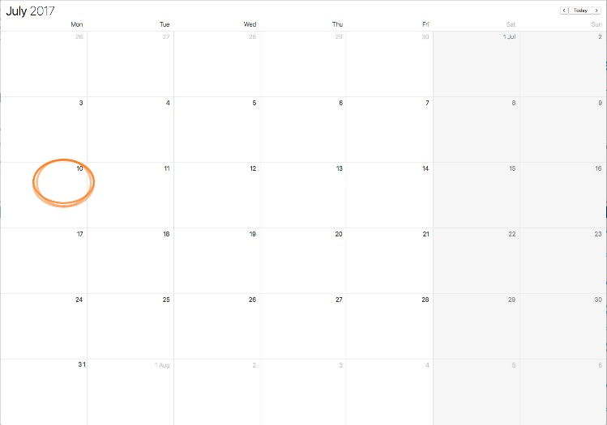
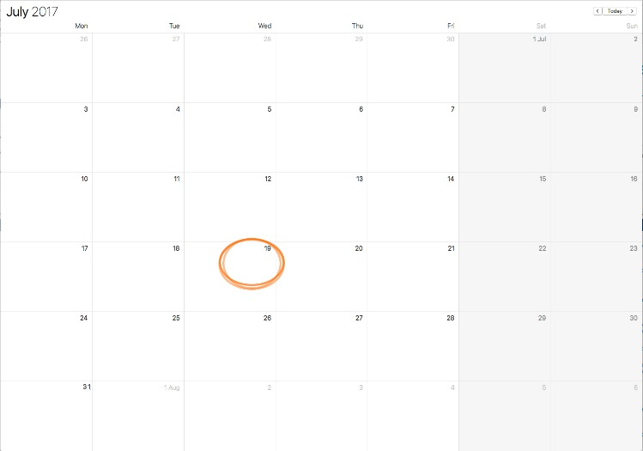
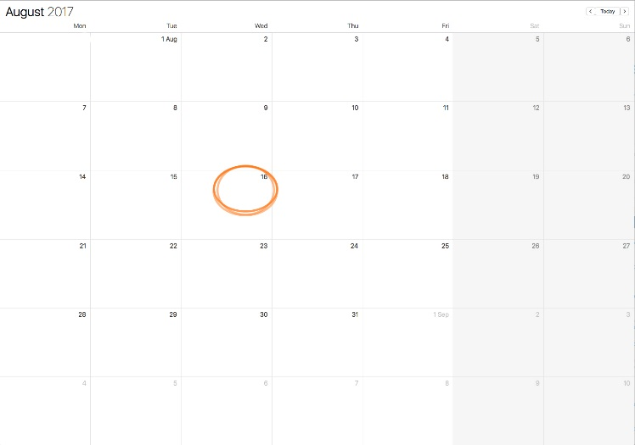
Response to requests for information and re-advertisement of application
Full response to notices 10 July 2017
Application re-advertised 19 July 2017
Comments close 16 August 2017
Notes:
The full response to both S22 notices was received on 10 July 2017. EPA has notified submitters and readvertised the application to inform people that this information available on our website and open for further comments.
EPA is also continuing our assessment of the application and the further information.

Slide 13
Making a submission
The community is invited to make a submission on the new information received
Information available on the EPA Wyndham web page
Use today to ask questions and learn more about the responses
Submissions can be emailed or sent through the post
Closing date is 16 August 2017

Slide 14
Works Approval next steps
1
Further information received has been made publicly available and open for comment until 16 August.
Technical assessments of further information is underway
Consideration of further public submissions once received

Slide 15
Works Approval next steps
1
Further information received has been made publicly available and open for comment until 16 August.
2
Completion of Technical Assessment:
Compliance against legislation
Analysis of key issues to determine likelihood of pollution and hazard occurring
Technical assessments of further information received
Consideration of further public submissions

Slide 16
Works Approval next steps
1
3
Once decision made to approve or refuse: Notification to submitters and publication of Assessment Report
Further information received has been made publicly available and open for comment until 16 August.
2
Completion of Technical Assessment:
Compliance against legislation
Analysis of key issues to determine likelihood of pollution and hazard occurring
Technical assessments of further information received
Consideration of further public submissions
Notes:
When a decision is made on the WA Application by the [CEO of the] Authority, all submitters will be notified of the decision with associated media releases. The detailed technical Assessment Report and a non-technical community report will also be prepared and made available for viewing and downloading from the EPA’s website.

